Slide 1

Online Safety Annual Update
Jen Harris & Jordan Graham
Notes:
stress that the internet offers amazing opportunities, it allows our children to learn, be creative and sociable and have fun – we’re not here to demonise the internet. When we send our children out into the real world to go to school, attend clubs and birthday parties we’ve already taught them about road safety, put boundaries in place about where and when they are allowed to go and we’ve probably guided them through friendship issues and any other worries they might have. When our children step out into their virtual world, it’s exactly the same - we have to ensure that there are boundaries and rules in place and that our children are aware of the risks and that they have the skills to navigate them – keeping themselves as safe as possible.

Slide 2
Know the 4 categories of online risk.
Identify indicators of online harm.
Demonstrate a child centred approach.
Explain your school’s reporting process.
Apply critical thinking to a given scenario to identify risk.
Notes:
Introduce yourself and set out plan for the session - to ensure we’re aware of key risks, review best practice to ensure staff and students are best protected when using IT inside and outside of school.

Slide 3
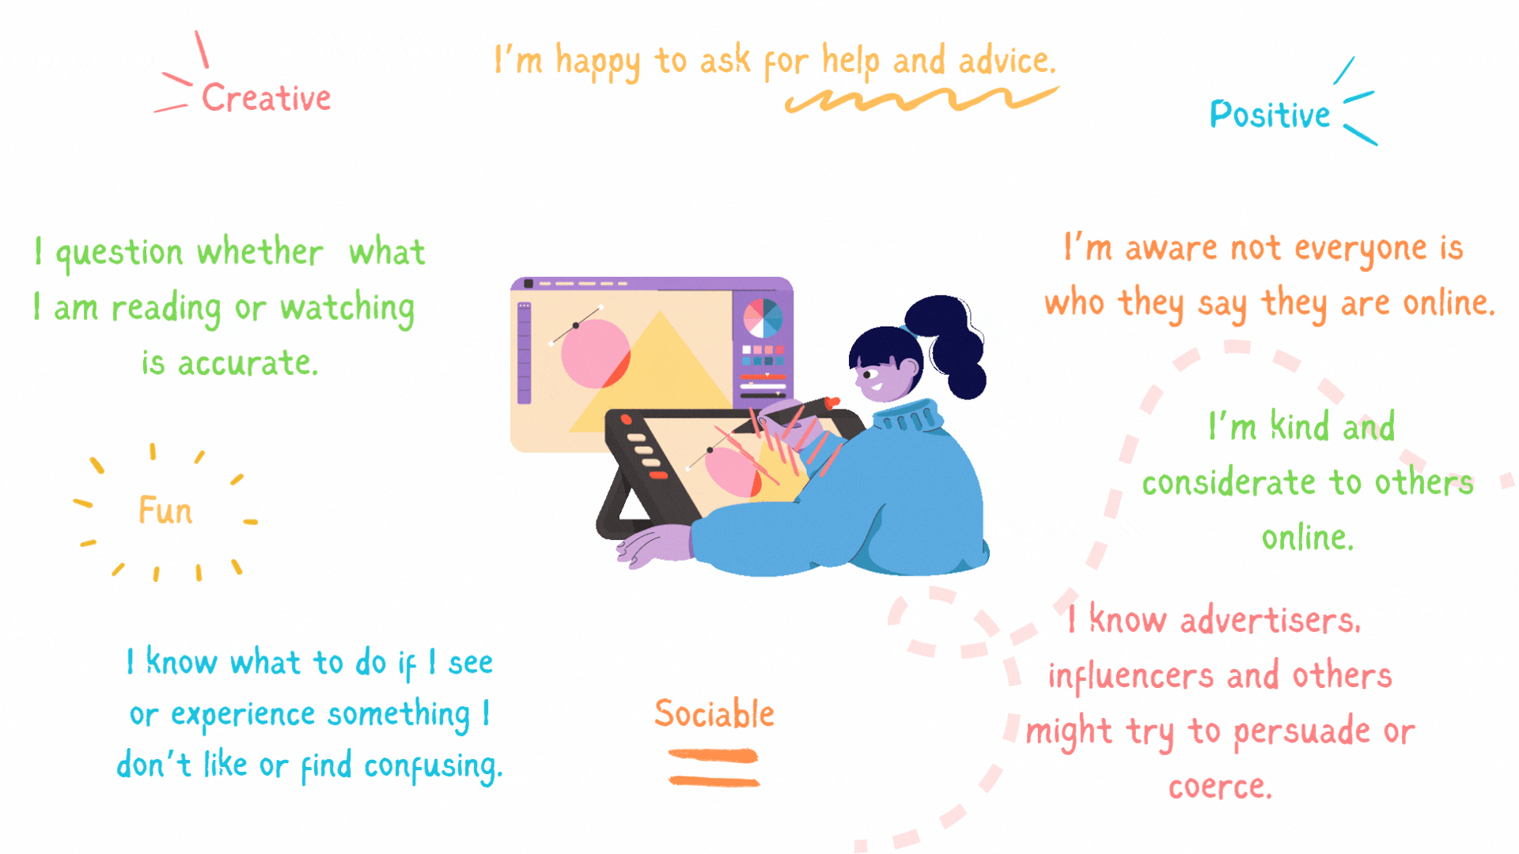
Infographic – the digitally resilient child.
Notes:
Our aim as teachers is to support our children to be digitally resilient –so that they can have fun, learn and be creative whilst having the knowledge and critical thinking skills to stay safe.

Slide 4

Risks: The four Cs
Content - What they might see.
Contact - Who they might speak to.
Conduct - How they behave.
Commerce - Online Gambling, in-app purchases, inappropriate advertising.
Notes:
KCSIE categorises online risk into these four areas. It can be useful to remember the 4 Cs and use these when assessing a website, app or game the children you work with are accessing.

Slide 5
Contact
Being subjected to harmful online interaction with other users; for example: peer to peer pressure, commercial advertising and adults posing as children or young adults with the intention to groom or exploit them for sexual, criminal, financial or other purposes.
Notes:
Contact focuses on who young people interact with online, covering harmful communication with other users as well as emerging interactions with artificial intelligence."

Slide 6
Examples of harmful online contact
Bullying, exclusion from social groups, peer pressure.
Adults posing as children / young adults to groom or exploit them for sexual, criminal, financial (sextortion)or other purposes.
Synthetic contact (AI chatbots)
AI-facilitated impersonation.

Slide 7
Emerging risk: AI - Chatbots
KCSIE 2026 expands Contact Risk beyond human-to-human interaction to include non-human, synthetic entities and AI-facilitated grooming dynamics.
Over two-thirds of young people (aged 9–17) regularly interact with AI chatbots; 58% of 9–12 year-olds access platforms designed for ages 13+.
Young people turn to chatbots for companionship.
Nearly 1 in 4 young people use chatbots to seek advice on personal issues, mental health, or relationships.
Notes:
Moving on to our second slide on Contact risks, we need to talk about an emerging area that KCSIE 2026 explicitly highlights: synthetic contact and AI chatbots. Historically, contact risk meant a young person interacting with another human online. Today, contact includes interactions with non-human AI entities.
To put the scale into perspective: around two-thirds of young people aged 9 to 17 are actively using AI chatbots, and usage of platforms like ChatGPT has almost doubled in just 18 months. Crucially, 58% of children aged 9 to 12 report using these tools, despite most platforms having a minimum age requirement of 13.
From a safeguarding perspective, there are two primary contact dynamics we need to be aware of:
Synthetic Friendships & Emotional Dependency: Over a third of children who use chatbots say it feels like talking to a real friend. That figure jumps to almost a quarter among vulnerable children using them specifically because they feel they have no one else to talk to. Chatbots are programmed to be endlessly patient, empathetic, and agreeable. They never challenge the user, which can create a false sense of intimacy and emotionally isolate vulnerable children from seeking real-world support.
Unsafe Advice & Misplaced Trust: Nearly a quarter of young chatbot users turn to AI for advice on personal dilemmas, mental health, or body image. Alarmingly, 40% of young people have absolute trust in the advice given, with no concerns about following it. User testing shows these models can bypass safety filters and provide inaccurate, inappropriate, or dangerous guidance.
Because safety controls remain inconsistent and under-age access is widespread, staff must understand that synthetic contact is a genuine safeguarding issue.
This is a complex and rapidly evolving topic. If your team would like to explore AI related risks in more depth, we have a 30 minute add on session available - we’d recommend that at the very least your DSL accesses this additional material.

Slide 8
Conduct
Personal online behaviour that increases the likelihood of, or causes, harm; for example, making, sending and receiving explicit images (for example: consensual and non-consensual sharing of nude and semi-nude images and/or sexually explicit images, photos or videos), cyberbullying and hate speech.
Notes:
Conduct focuses on how young people behave online and how their personal actions can cause harm to themselves or others.

Slide 9
Overview of Conduct
Explicit Image Sharing: Consensual and non-consensual sending, receiving, or forwarding of nude, semi-nude, or sexually explicit photos/videos.
Cyberbullying & Hate Speech: Online harassment, targeted abuse, exclusion, and spreading discriminatory content (e.g., misogyny, racism).
Cybercrime (Computer Misuse Act Offences): Involvement in hacking, DDoS attacks, or unauthorised network access.
AI Image Manipulation & Nudification: Using generative AI tools or apps to alter, "undress," or create sexually explicit images of peers or staff (illegal under UK law).
Notes:
Under KCSIE 2026, conduct encompasses traditional concerns such as cyberbullying, hate speech, and the sharing of nude or semi-nude images. However, we must also recognise how technology has expanded what 'harmful conduct' looks like today:
Cybercrime as a Safeguarding Issue: KCSIE 2026 places an expanded focus on Computer Misuse Act offences. When students engage in cybercrime—such as launching DDoS attacks against school systems or attempting unauthorized access—this should be treated as a safeguarding vulnerability and a sign of potential exploitation or manipulation, rather than purely a disciplinary issue.
AI-Generated Image Abuse: Conduct now explicitly includes pupils using AI apps or 'nudification' tools to generate or alter photos of peers or staff into sexually explicit images. creating, possessing, or sharing AI-generated explicit images of anyone under 18 is illegal CSAM under UK law, regardless of whether a real camera was used.
Understanding these boundaries helps us spot early warning signs and guide pupils toward safer online choices
Let's look at how this plays out in practice with a real-world scenario of an online group chat.
Immediately after the simulation, the video will transition to a yellow overview screen. Please pause the video at that screen and refer to your teacher notes to begin your group discussion.

Slide 10
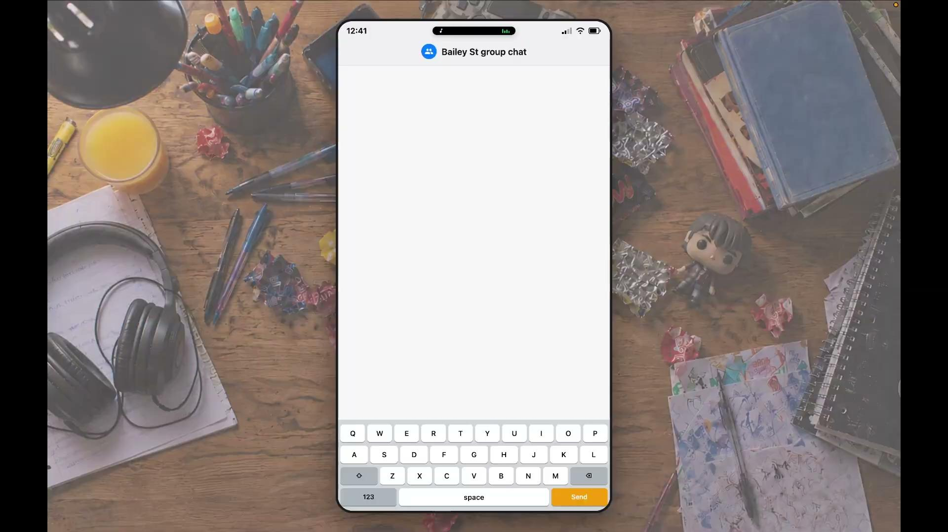
Simulation 1

Slide 11

Discuss: Online Interactions
The Year 5 Group Chat - Classroom Spillover:
It is Monday morning. Before registration has even finished, three Year 5 girls are in tears, and a boy is refusing to come into class. Over the weekend, a WhatsApp group, which a large proportion of the class belong to, despite being under 13, has turned nasty.
It transpires that one child created a cruel meme using a photo of the boy from sports day and shared it. Others laughed, some stayed silent, and one child was kicked out of the group for telling them to stop. The parents of the boy have just emailed the headteacher, demanding the school "punish the bullies." Meanwhile, the parents of the child who made the meme argue, "It happened on a Sunday on their own phones, the school has no right to get involved."
Notes:
Here is an example of how online interactions can become harmful, this scenario could fall into various categories - how the young people CONDUCT themselves, CONTACT as the children interact with one another in a harmful way, and also CONTENT with regards to the image that was produced.
OK, please pause the presentation here and refer to the session notes for your talking points.
Resume the video when you’re ready.

Slide 12
Online Safety Annual Update
Jen Harris & Jordan Graham
Notes:
Welcome back

Slide 13
Content
Being exposed to illegal, inappropriate, or harmful content, for example: pornography, fake news, racism, misogyny, self-harm, suicide, anti-Semitism, radicalisation, and extremism.
Notes:
Content focuses on what young people see, hear, or read online, and the potential harm caused by exposure to illegal, inappropriate, or harmful material

Slide 14
Content overview
Algorithmic ‘Rabbit Holes’: Engagement algorithms pushing pupils from superficial interest into increasingly extreme echo chambers.
Misogyny & Harmful Ideologies: Exposure to discriminatory rhetoric, hate speech, radicalisation, and content permissive of sexual harassment.
Misinformation & AI Synthetic Content: Fake news, AI deepfakes, and hallucinations that distort reality and erode critical thinking.
Covert Influence: Unlabelled influencer promotions, subtle advertising, and persuasive content disguised as peer advice.
Notes:
Content risk exists on a broad spectrum. At one end, it begins with subtle commercial persuasion—influencer marketing, unlabelled promotions, or covert ads that create problems young people didn't know they had, often appearing as friendly top tips.
Moving along that spectrum, we see the impact of misinformation, fake news, and increasingly, AI-generated synthetic media and deepfakes, which blur the line between fact and opinion.
Further along the scale lies more dangerous, extreme content. Online platforms use algorithms designed to maximise engagement. When a vulnerable, disengaged, or lonely young person clicks on a video, the algorithm repeatedly feeds them similar, stronger material. What starts as superficial viewing quickly becomes an algorithmic 'rabbit hole' or echo chamber, reinforcing negative messaging and driving them toward misogynistic rhetoric, hate speech, or radicalisation.
Crucially, radicalisation and extreme ideologies exploit real-world vulnerabilities—such as isolation, bullying, or a lack of belonging. KCSIE 2026 explicitly highlights misogyny, anti-Semitism, and online hate alongside radicalisation.
Our most powerful defence is twofold: first, equipping pupils with media literacy and critical thinking skills to recognize when they are being manipulated; and second, maintaining a supportive, emotionally literate environment where young people feel connected and far less susceptible to online hate groups.

Slide 15
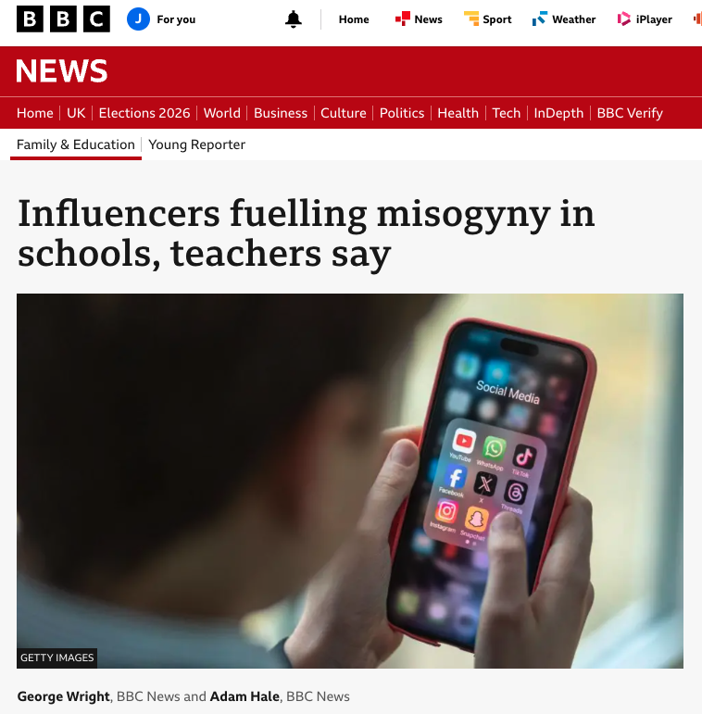
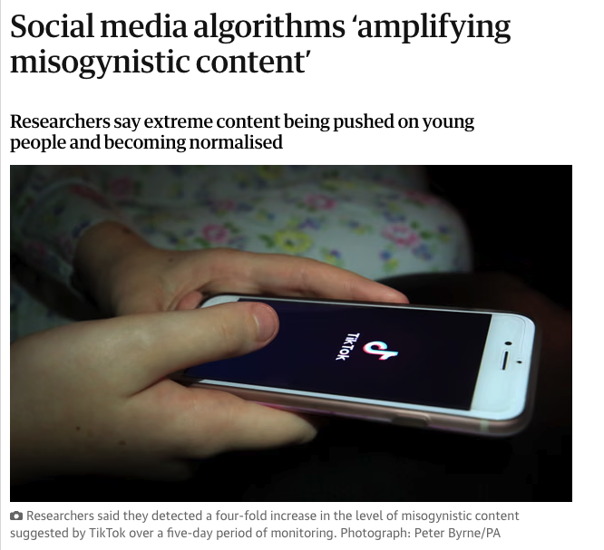

About Misogyny
Notes:
Misogyny is a form of hate that sits within the category of content, which directly targets women and girls. Online, it is heavily promoted within a network of forums, creators, and communities known collectively as the 'manosphere.'
High-profile influencers in this space peddle increasingly radical and sensationalized ideas to capture the attention of vulnerable young people. By mixing basic self-improvement advice with hate-driven content, they place immense pressure on boys to look and behave a certain way—all designed to drive algorithmic engagement and maximize profit.
Let's look at how this plays out in practice with a real-world scenario of a pupil being pulled into the online world of the manosphere. Pay close attention to how simple, innocent searches—like basic fitness tips—can gradually trigger algorithms that lead a user down an extreme 'rabbit hole.' While accelerated for the purposes of this presentation, this reflects the real escalation many young people experience.
Immediately after the simulation, the video will transition to a yellow overview screen. Please pause the video at that screen and refer to your teacher notes to begin your group discussion.

Slide 16
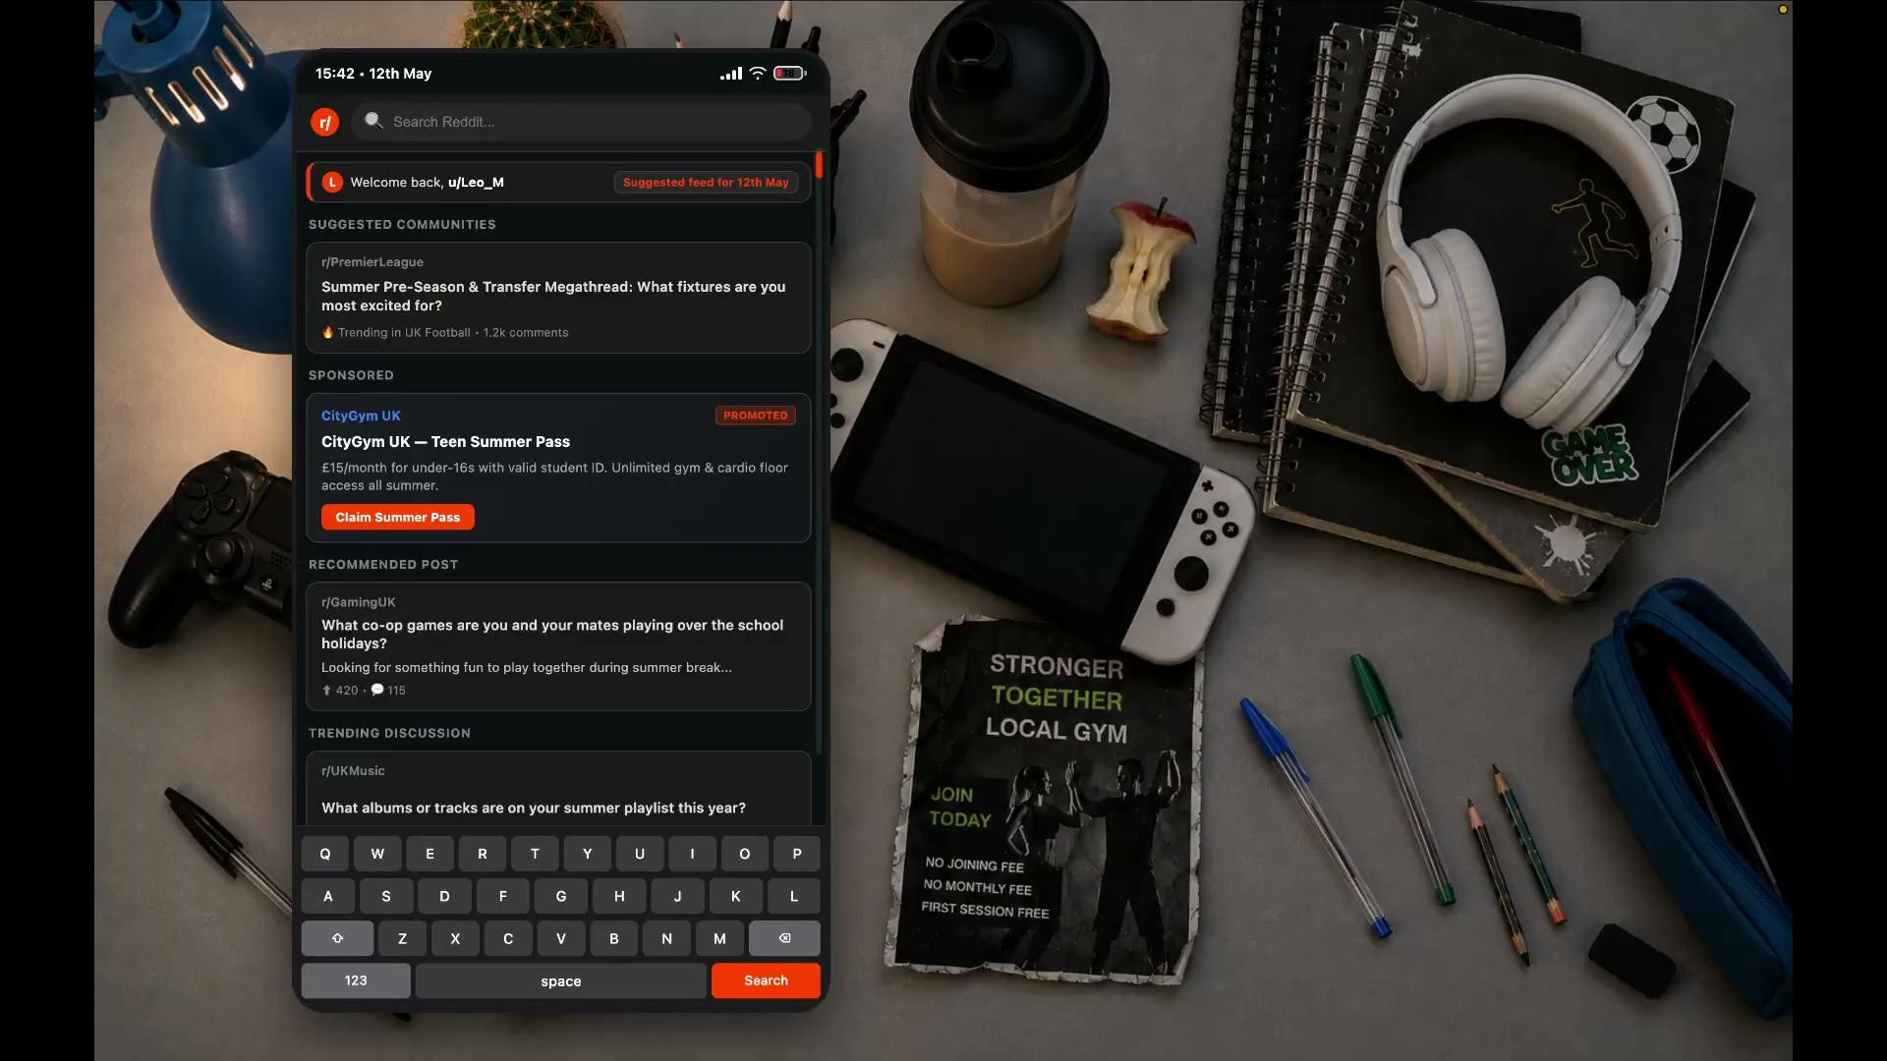
Simulation 2

Slide 17
Discuss: Misogyny & the Manosphere
The Story of "Leo" (Year 8):
Leo is a relatively quiet 12-year-old, who recently started going to the gym. He goes on TikTok and YouTube Shorts to look up workout routines and "how to build muscle."
Because the algorithm prioritises high-engagement content, over time his feed transitions from standard fitness advice to "hustle culture" (how to get rich quick) and "alpha male" visual podcasts. Within a month, Leo is immersed in the "manosphere." The influencers he watches tell him that men are oppressed by society, that traditional education is a "matrix" designed to keep him poor, and that women owe men submissiveness.
A few weeks later, a female substitute teacher asks Leo to hand out some worksheets. Leo refuses, stating, "I don't take orders from women."

Slide 18
Online Safety Annual Update
Jen Harris & Jordan Graham
Notes:
Welcome back

Slide 19
Commerce
Risks such as online gambling, inappropriate advertising, phishing and or financial scams.
Notes:
Commerce focuses on how young people are exposed to financial harms online, ranging from manipulative platform designs and targeted advertising to scams and commercial exploitation.

Slide 20
Commerce overview
Phishing & Financial Scams: Malicious links, fake giveaways (e.g., "free in-game currency"), and malware designed to harvest personal credentials or bank details.
Game Monetisation & Gambling Dynamics: Loot boxes, mystery rewards, and virtual currencies engineered to encourage impulsive, repeatable spending.
Targeted & Inappropriate Ads: Algorithmic advertising populating games, pop-ups, and video streams, often exposing pupils to age-inappropriate content.
Covert Influencer Marketing: Paid promotions, unlabelled ads, and "finfluencers" subtly recommending products or schemes under the guise of friendly advice.
Notes:
Both KCSIE 2026 and the updated statutory RSHE guidance place a significantly stronger emphasis on digital financial harms. Children are no longer just browsing the internet—they are active consumers in a digital marketplace designed to monetise their attention and curiosity.
Commerce risks generally fall into three key areas:
Scams & Cyber Security Exploitation: Young people are frequently targeted through malicious links or 'free giveaway' scams—like offers for free game skins or currency. Phishing attacks exploit a child's naivety to compromise accounts or access shared family devices, which can also expose staff or school networks if devices are shared.
Game Monetisation & Addiction Loops: Mechanics like loot boxes, battle passes, and virtual currencies obscure real-world monetary value. They use subtle psychological tactics to create gambling-like experiences, often resulting in accidental overspending, debt, or distress.
Covert & Targeted Advertising: From unlabelled influencer sponsorships to pop-up ads within casual games, pupils are constantly persuaded to buy products or sign up for services without realizing they are being targeted by a commercial campaign.
Building financial literacy and critical thinking is essential so young people can recognise when they are being commercially manipulated or targeted by scams."

Slide 21
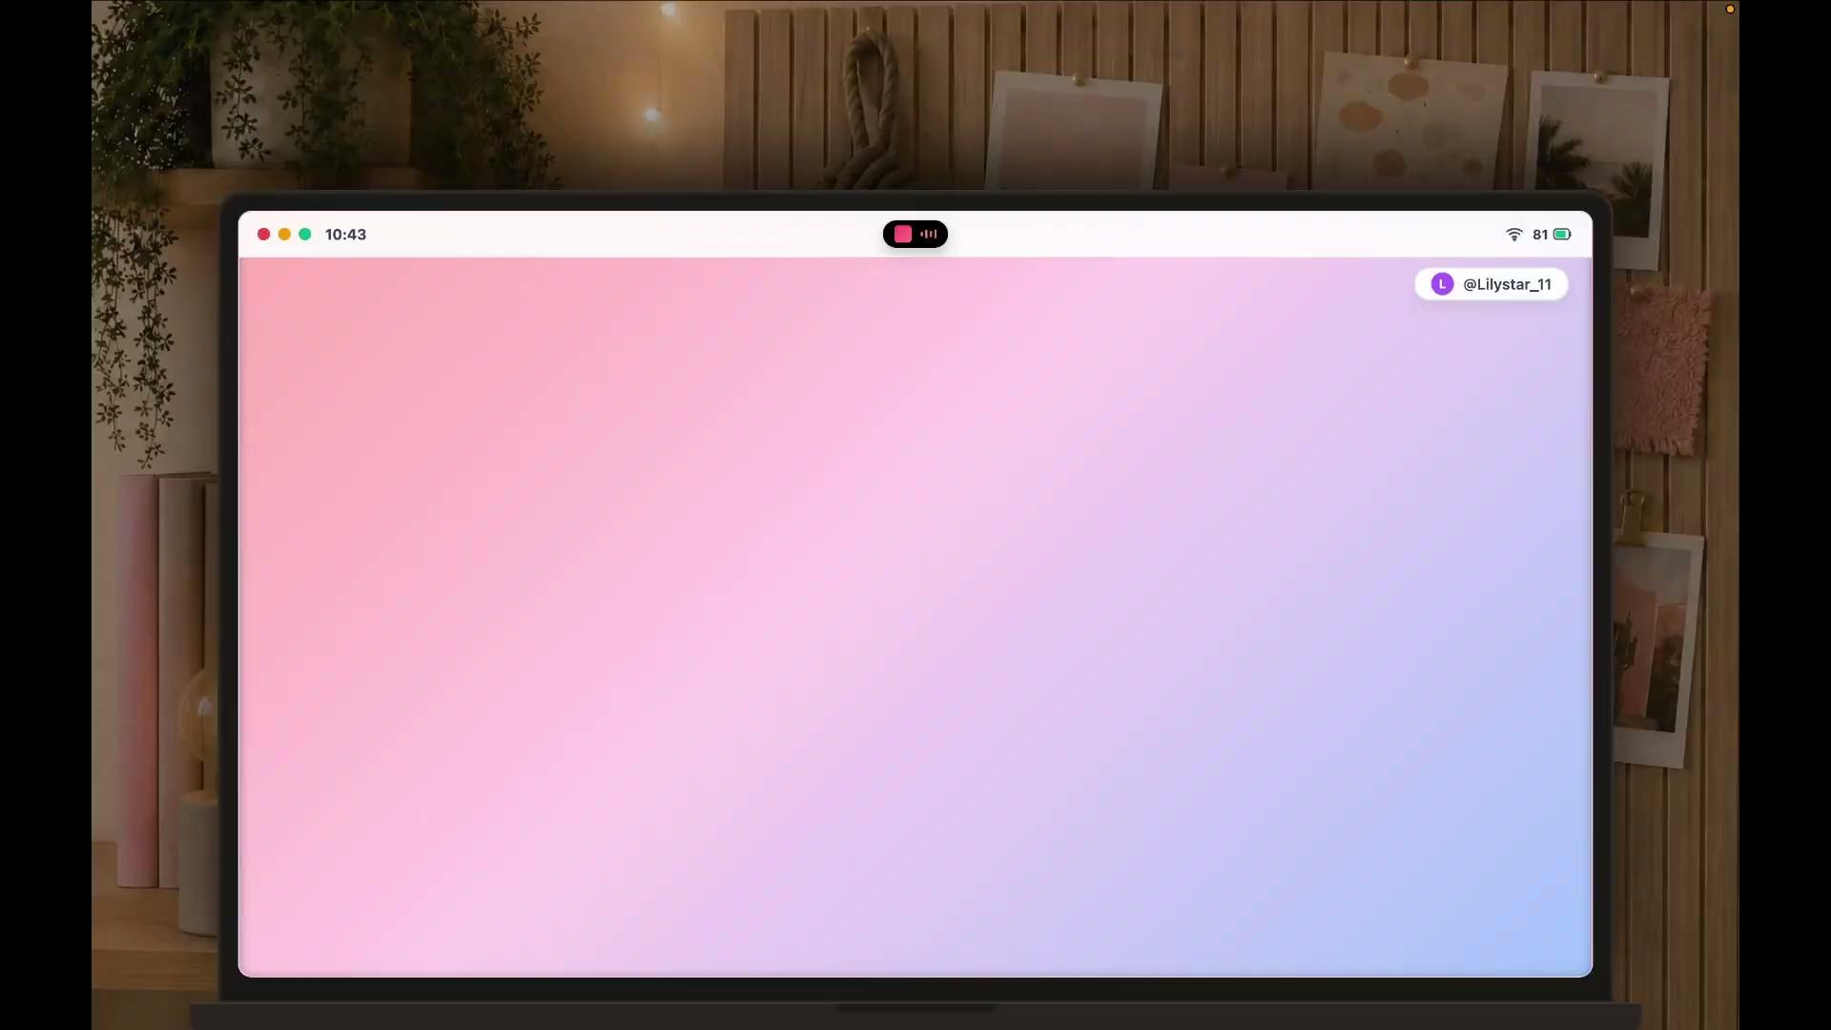
Simulation 3
Notes:
Play simulation first - start to read these notes when the final screen of text appears outlining the commissioners report.
The simulation we’ve just watched represents the daily digital reality for millions of young people across the UK. We’ve chosen to highlight this particular aspect of commerce related online risk to highlight findings of the Children’s Commissioner’s report, 'A Healthy Influence?',
Point 1: Subtle Soft-Selling
First, notice how commercial messages are introduced. Influencers build high-trust, 'big sister' relationships with their young audience through casual, relatable lifestyle content. By lowering children's critical guardrails first, product plugs like 'Ella Rose's morning routine' feel less like adverts and more like friendly advice.
Point 2: The Playground Status Shift
Second, this soft-selling has fundamentally shifted the attention of many children, even among children as young as those in Years 5 and 6. Are seeing skin care products, fitness regimes and supplement content - previously only targeted to older consumers.
Point 3: Age-Inappropriate Content & Safety Bypasses
Research shows that 86% of children aged 8 to 12 follow influencers daily. Many access these platforms using shared, parental, or unverified accounts—completely bypassing age-appropriate safety filters and exposure guardrails.
Point 4: Algorithmic Escalation
algorithms compound the issue. A single view of a workout or lifestyle video triggers a cascade of targeted ads, pushing aesthetic micro-cultures that normalise adult beauty standards far too early in a child's development.
Point 5: Manufactured Insecurity & Impact
Finally, the report explains that emotional impact is significant. Seventy-eight percent of young people report that seeing appearance-altering products and hyper-curated lifestyles online directly hurts their self-esteem and body image. They are aware of this impact but continue to follow and interact with these accounts. One young person interviewed described how social media influencers and advertisements overtime, told her that she should be worried about everything from her skin to the shape of her nose - and then tried to offer her a product or service to ‘fix it’.
As educators and policymakers, understanding these mechanisms—from subtle influencer hooks to targeted commercial algorithms—is the first step toward equipping young people with the critical digital literacy they need to navigate today's online world safely.

Slide 22
Contact
Conduct
Content
Commerce
Notes:
We’ve covered the 4 categories of risk as outlined by KCSIE, these categories can be applied to any app, game or website to help you evaluate potential risks.
As we now look at how children are spending their time online, see if you can identify where activities might fall within one or more of these categories.

Slide 23
Ages 5-7
Early Explorers
Educational apps/games
Streaming videos (e.g., YouTube Kids)
Simple creative apps
Emerging: Messaging, video platforms, gaming
Notes:
For our younger children, those aged 4-7, who are in the early years or Key Stage 1, their online world is often about being 'early explorers.' They're mainly engaged with educational apps and games for learning phonics, numbers, or puzzles. They love watching streaming videos on platforms like YouTube Kids or CBeebies apps, usually with supervision. They also enjoy simple creative apps for drawing or storytelling. What we're seeing emerging in this group is some access to messaging apps like WhatsApp or video platforms like TikTok or Instagram, sometimes even gaming. This is often with parental guidance, but sometimes it can be unsupervised, which is something to be mindful of.

Slide 24
Ages 8-11
Growing Independently
Sophisticated Online Gaming (chat features)
Increased YouTube use
Early Social Media
Smart Speakers, online schoolwork
Notes:
As children move into the 8-11 age range, or Key Stage 2, we can describe them as 'growing independently' online. They engage in more sophisticated online gaming, often with multiplayer features and in-game chat, on popular platforms like Minecraft, Roblox, or Fortnite. We see an increased use of YouTube not just for entertainment but also for tutorials or content related to their interests. This is also the age when many children start their early adoption of social media platforms like Instagram, Snapchat, or TikTok, often before they meet the official age limits, which is a key area for parental guidance. They also use smart speakers and other voice-activated devices, and start using online resources for schoolwork."
.

Slide 25
Ages 12-14
Ages 12- Teen digital Lives
Intensive Social Media
Complex online gaming
Online identity and self expression
Private group communication
Online research and communities
Notes:
For children aged 12-14+, moving into early secondary school or Key Stage 3 and beyond, their online lives become significantly more complex. We see intensive social media use, with deeper engagement on platforms like Instagram, Snapchat, TikTok, Facebook, and various messaging apps like WhatsApp or Discord. Their focus shifts strongly to interaction with friends, forming their own identity, and following trends.
Online gaming becomes more competitive, often involving unmoderated voice or text chat with strangers. They’ll be consuming far more online content independently, streaming a wider range of content, including user-generated content like podcasts and vlogs. This is also a crucial time for online identity and self-expression, as they start curating their own digital presence. They rely heavily on private group communication across multiple platforms. The internet becomes a primary tool for research and learning for school projects, and they actively seek out online communities based on shared hobbies, fandoms, or interests."

Slide 26
Your Responsibilities
Read Part 1 of KCSIE.
Complete online safety training at induction and at least annually thereafter.
Contribute to a supportive and non-judgemental culture.
Adhere to your school policies (read, understand, sign)
Teach online safety in line with the latest RSHE curriculum. (September 2026).
Apply vigilance and professional curiosity: watching for identifiable indicators of harm, identify risks relating to the 4Cs, recognising technology's role in safeguarding issues.
Report any online safety concern directly to the Designated Safeguarding Lead (DSL) or deputy, calling 999 if a child is in immediate danger.
Understand school filtering and monitoring basics
Notes:
If you are a member of the SLT, governing body or the DSL - please see our follow on resource that outlines additional responsibilities - this slide is aimed at those responsibilities that apply to us all.
*click*
KCSIE explicitly lays out your expected role within the school's online safety structure
Safeguarding and online safety training is not a one-off tick-box exercise. All staff must complete formal online safety training during their induction, followed by annual updates. These sessions ensure we remain up to date with emerging digital risks, evolving online harms, and our specific responsibilities for keeping children safe online
Technology plays a role in nearly every modern safeguarding issue. We must exercise 'professional curiosity'—looking beyond the surface of what a child tells us or how they behave. Always evaluate online risks through the framework of the 'four Cs
Safeguarding is everyone’s responsibility. Never assume someone else will act or that a digital concern is too minor to log. If you notice a concern—whether it is an alarming search query, a pupil disclosure, or a change in behaviour—report it directly to the Designated Safeguarding Lead (DSL) or deputy immediately using your school logging procedure. Never promise absolute confidentiality to a pupil. If you assess that a child is in immediate danger of serious harm, call 999 without delay.
When responding to incidents involving nudes, semi-nudes, or AI-generated deepfakes, strictly adhere to legal protocols. Teachers must never view, download, screenshot, print, save, or forward an explicit or illegal image of a child—doing so can be a criminal offence. If a pupil's mobile phone or device contains potential digital evidence, confiscate and securely store the device without looking through it yourself, and hand it straight to the DSL or the police.
Pupils who experience online harassment, cyberbullying, or non-consensual image sharing often experience deep shame and fear. When a child comes to you, reassure them immediately that they are being taken seriously, will be supported, and will be kept safe. We must actively prevent victim-blaming attitudes—no child should ever be made to feel responsible for online abuse or exploitation inflicted upon them.
While the Senior Leadership Team and IT staff manage our technical infrastructure, classroom teachers are the front-line checks for filtering and monitoring in practice. There are four essential points every teacher needs to know:
Understand the basics: You must be aware that automated filtering—blocking harmful content—and monitoring—tracking flagged keywords or searches—are active across all school devices, and understand how concerns are escalated.
Maintain active supervision: Technical filters are never 100% foolproof. Filtering does not replace active teacher supervision whenever pupils are using laptops, tablets, or computers in your lesson.
Report breaches or bypasses immediately: If a pupil accidentally accesses inappropriate content, attempts to use a VPN or proxy site, or sets up a personal mobile hotspot to get around school restrictions, you must report this to the DSL and IT team straight away.
Flag 'over-blocking': Filtering should protect pupils without creating unreasonable restrictions. If a system over-blocks legitimate educational resources or prevents you from teaching online safety, report this so system adjustments can be made.
Preventative education equips pupils with the critical thinking skills needed to stay safe online. Through your planned Relationships, Sex, and Health Education (RSHE) curriculum, we must cover vital contemporary digital topics. This includes helping pupils understand the impact of online influencers, the ethical risks around Generative AI and deepfakes, online harms, and giving them practical knowledge of how and where to report concerns safely.

Slide 27
Your Responsibilities
Report any online safety concern directly to the Designated Safeguarding Lead (DSL) or deputy, calling 999 if a child is in immediate danger.
Immediate action is essential
Handle harmful digital imagery correctly
Report to your DSL or their deputy
They should record the concern
If you have a concern around a colleague, report to your headteacher. If the report concerns the headteacher report to the chair of governors.
Where allegations meet a harm threshold, leadership will escalate to the LADO.
Notes:
If you are a member of the SLT, governing body or the DSL - please see our follow on resource that outlines additional responsibilities - this slide is aimed at those responsibilities that apply to us all.
*click*
KCSIE explicitly lays out your expected role within the school's online safety structure
Safeguarding and online safety training is not a one-off tick-box exercise. All staff must complete formal online safety training during their induction, followed by annual updates. These sessions ensure we remain up to date with emerging digital risks, evolving online harms, and our specific responsibilities for keeping children safe online
Technology plays a role in nearly every modern safeguarding issue. We must exercise 'professional curiosity'—looking beyond the surface of what a child tells us or how they behave. Always evaluate online risks through the framework of the 'four Cs
Safeguarding is everyone’s responsibility. Never assume someone else will act or that a digital concern is too minor to log. If you notice a concern—whether it is an alarming search query, a pupil disclosure, or a change in behaviour—report it directly to the Designated Safeguarding Lead (DSL) or deputy immediately using your school logging procedure. Never promise absolute confidentiality to a pupil. If you assess that a child is in immediate danger of serious harm, call 999 without delay.
When responding to incidents involving nudes, semi-nudes, or AI-generated deepfakes, strictly adhere to legal protocols. Teachers must never view, download, screenshot, print, save, or forward an explicit or illegal image of a child—doing so can be a criminal offence. If a pupil's mobile phone or device contains potential digital evidence, confiscate and securely store the device without looking through it yourself, and hand it straight to the DSL or the police.
Pupils who experience online harassment, cyberbullying, or non-consensual image sharing often experience deep shame and fear. When a child comes to you, reassure them immediately that they are being taken seriously, will be supported, and will be kept safe. We must actively prevent victim-blaming attitudes—no child should ever be made to feel responsible for online abuse or exploitation inflicted upon them.
While the Senior Leadership Team and IT staff manage our technical infrastructure, classroom teachers are the front-line checks for filtering and monitoring in practice. There are four essential points every teacher needs to know:
Understand the basics: You must be aware that automated filtering—blocking harmful content—and monitoring—tracking flagged keywords or searches—are active across all school devices, and understand how concerns are escalated.
Maintain active supervision: Technical filters are never 100% foolproof. Filtering does not replace active teacher supervision whenever pupils are using laptops, tablets, or computers in your lesson.
Report breaches or bypasses immediately: If a pupil accidentally accesses inappropriate content, attempts to use a VPN or proxy site, or sets up a personal mobile hotspot to get around school restrictions, you must report this to the DSL and IT team straight away.
Flag 'over-blocking': Filtering should protect pupils without creating unreasonable restrictions. If a system over-blocks legitimate educational resources or prevents you from teaching online safety, report this so system adjustments can be made.
Preventative education equips pupils with the critical thinking skills needed to stay safe online. Through your planned Relationships, Sex, and Health Education (RSHE) curriculum, we must cover vital contemporary digital topics. This includes helping pupils understand the impact of online influencers, the ethical risks around Generative AI and deepfakes, online harms, and giving them practical knowledge of how and where to report concerns safely.

Slide 28
Your Responsibilities
Understand school filtering and monitoring basics
Fortinet & Senso
Governing body, SLT, DSL responsible for set up and management of these systems
Maintain active supervision, ensure pupils now how to report to you
Report breaches and bypasses
Notify of potential future flagging
Flag over-blocking
Notes:
If you are a member of the SLT, governing body or the DSL - please see our follow on resource that outlines additional responsibilities - this slide is aimed at those responsibilities that apply to us all.
*click*
KCSIE explicitly lays out your expected role within the school's online safety structure
Safeguarding and online safety training is not a one-off tick-box exercise. All staff must complete formal online safety training during their induction, followed by annual updates. These sessions ensure we remain up to date with emerging digital risks, evolving online harms, and our specific responsibilities for keeping children safe online
Technology plays a role in nearly every modern safeguarding issue. We must exercise 'professional curiosity'—looking beyond the surface of what a child tells us or how they behave. Always evaluate online risks through the framework of the 'four Cs
Safeguarding is everyone’s responsibility. Never assume someone else will act or that a digital concern is too minor to log. If you notice a concern—whether it is an alarming search query, a pupil disclosure, or a change in behaviour—report it directly to the Designated Safeguarding Lead (DSL) or deputy immediately using your school logging procedure. Never promise absolute confidentiality to a pupil. If you assess that a child is in immediate danger of serious harm, call 999 without delay.
When responding to incidents involving nudes, semi-nudes, or AI-generated deepfakes, strictly adhere to legal protocols. Teachers must never view, download, screenshot, print, save, or forward an explicit or illegal image of a child—doing so can be a criminal offence. If a pupil's mobile phone or device contains potential digital evidence, confiscate and securely store the device without looking through it yourself, and hand it straight to the DSL or the police.
Pupils who experience online harassment, cyberbullying, or non-consensual image sharing often experience deep shame and fear. When a child comes to you, reassure them immediately that they are being taken seriously, will be supported, and will be kept safe. We must actively prevent victim-blaming attitudes—no child should ever be made to feel responsible for online abuse or exploitation inflicted upon them.
While the Senior Leadership Team and IT staff manage our technical infrastructure, classroom teachers are the front-line checks for filtering and monitoring in practice. There are four essential points every teacher needs to know:
Understand the basics: You must be aware that automated filtering—blocking harmful content—and monitoring—tracking flagged keywords or searches—are active across all school devices, and understand how concerns are escalated.
Maintain active supervision: Technical filters are never 100% foolproof. Filtering does not replace active teacher supervision whenever pupils are using laptops, tablets, or computers in your lesson.
Report breaches or bypasses immediately: If a pupil accidentally accesses inappropriate content, attempts to use a VPN or proxy site, or sets up a personal mobile hotspot to get around school restrictions, you must report this to the DSL and IT team straight away.
Flag 'over-blocking': Filtering should protect pupils without creating unreasonable restrictions. If a system over-blocks legitimate educational resources or prevents you from teaching online safety, report this so system adjustments can be made.
Preventative education equips pupils with the critical thinking skills needed to stay safe online. Through your planned Relationships, Sex, and Health Education (RSHE) curriculum, we must cover vital contemporary digital topics. This includes helping pupils understand the impact of online influencers, the ethical risks around Generative AI and deepfakes, online harms, and giving them practical knowledge of how and where to report concerns safely.

Slide 29
Personal Online Safety
Passwords (try 3 random words) and MFA
Tighten privacy & anonymity settings
Maintain strict professional boundaries
Mind your digital footprint
Be vigilant against phishing
Device & data security
Notes:
Secure Your Access
Our personal email and social accounts hold a vast amount of sensitive personal data. Avoid reusing passwords across sites. Use strong passphrases—combining three random words with symbols and numbers—or a dedicated password manager. Crucially, enable Multi-Factor Authentication (MFA) on your personal accounts; even if a password is compromised, MFA blocks unauthorized access.
2. Tighten Privacy & Anonymity Settings
Regularly audit your privacy settings across platforms like Facebook, Instagram, and TikTok. Ensure your profiles are set to private so that your posts, friend lists, and tagged photos are hidden from public view. Many teachers choose to use their middle name or a variation of their surname online to prevent pupils or parents from easily locating their personal profiles."
3. Maintain Strict Professional Boundaries
Always maintain a firm boundary between your personal and professional life. Never accept friend requests or follow requests from current pupils or their parents on personal accounts. All professional communication must go through official school channels and school-issued email addresses.
4. Mind Your Digital Footprint
Once something is uploaded online, control over that content is lost. Before posting, ask yourself if the content could be taken out of context or undermine your professional standing if viewed by a parent or employer. Be mindful not to share photos displaying school logos, lanyards, or identifiable workplace details.
5. Be Vigilant Against Phishing
Phishing scams are increasingly sophisticated and frequently exploit emotional urgency. Be cautious of unexpected emails, text messages, or direct messages asking for login verification or personal details. Always check sender email addresses carefully and hover over links to verify destination URLs before clicking.
6. Harden Device & Data Security
Keep all personal devices, applications, and operating systems up to date by enabling automatic software updates, which patch security vulnerabilities. Ensure your important personal documents are backed up to secure cloud storage or an external hard drive. Finally, never save personal passwords or leave personal accounts logged in on classroom computers or shared school hardware.

Slide 30
Wellbeing & Role Modelling
Curate your feed - be mindful about the content you consume.
Take a break, put boundaries in place for yourself
Make the most of your device / website / app settings
Enjoy the huge benefits that technology can bring, find balance
Consider whether you’re in control of your tech or does it control you.
Notes:
We always like to pop a brief reminder towards the end of this session about the impact technology can have on our wellbeing and the importance of being a good digital role model
As the big tech giants pour millions of pounds into making our devices and the apps we access, extremely addictive, we all, adults and young people alike, must be mindful about our time online and how it makes us feel.
Whether you’re a fan of instagram, TikTok, Youtube, you use your mobile for keeping up with the news or whatsapp to keep in touch with other parents at your child’s school - consider carefully curating the online content you consume. How does scrolling through this content make you feel? Are there some accounts you could unfollow or habits that could be reviewed?
Think about taking a break from your screens if you can, most devices come with brilliant tools that will allow you to configure ‘do not disturb’ or quiet times – you can even select which notifications to mute and which to allow through during those periods. This is particularly important when winding down in the evening to support a good nights sleep.
In general - aim to be in control of your use of technology, rather than it controlling you!

Slide 31

Digital Wellbeing by Google
Google: Digital Wellbeing

Slide 32
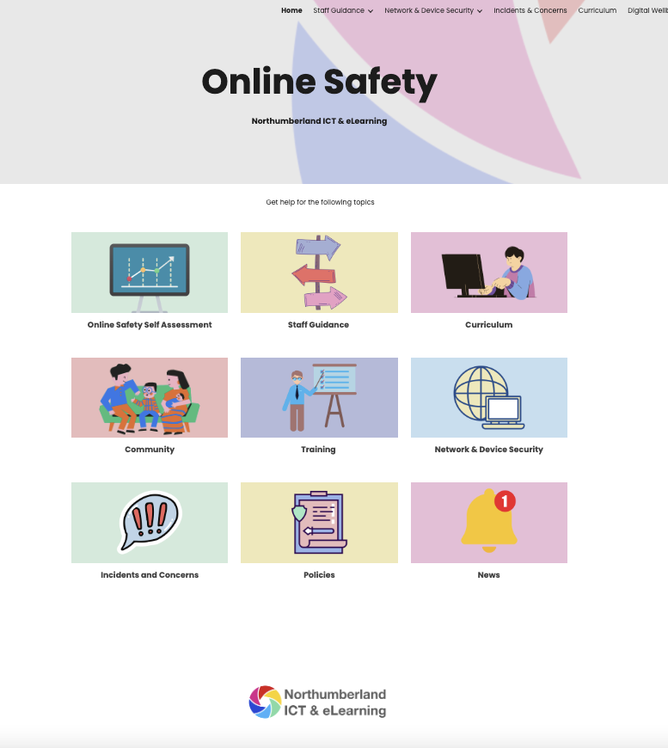

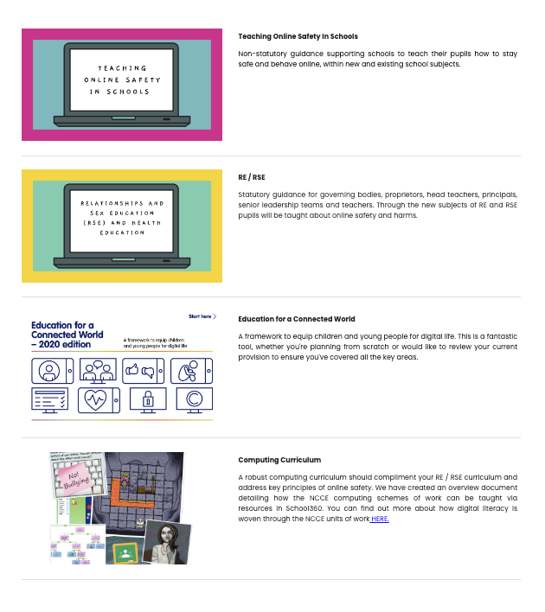
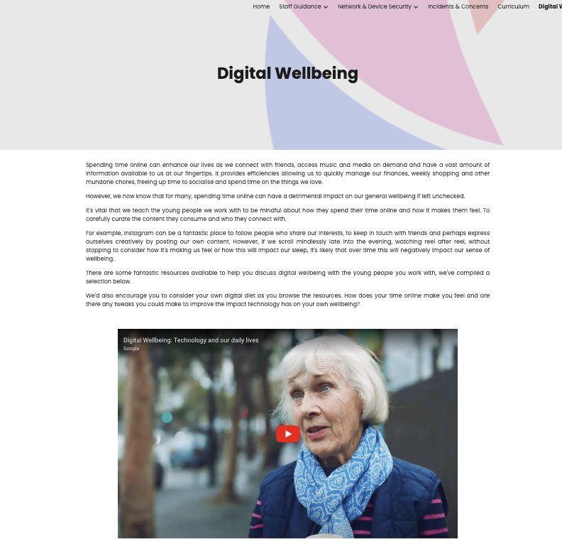
Online Safety Website
Notes:
For further information about online safety including a list of our recommended resources, head to our website using the QR code above, Here you’ll find links to School360, our online safety website and much more.

Slide 33
Further Training and Support
CEOP - deep dive half day course.
Online Safety at Home - for parents and carers
An introduction to AI in education
AI Risks to children
Teaching Online Safety
Cyber Awareness
Filtering, monitoring and Reporting.
See our guide for all available sessions and dates.
Notes:
https://northumberlandict.my.canva.site/support2627/

